Slide 1
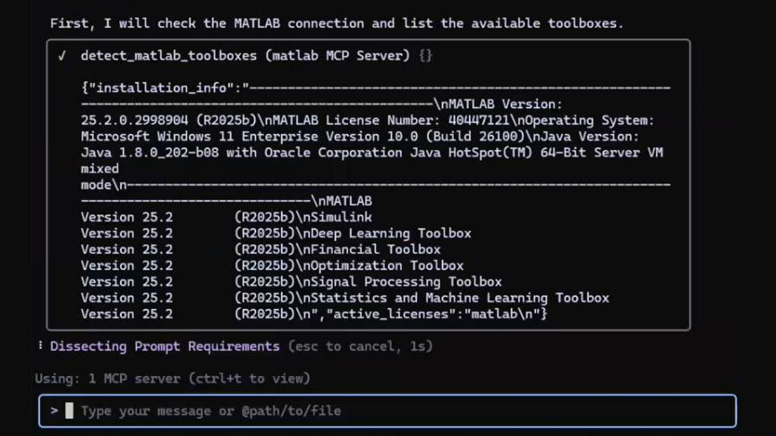
Agentic AI Workflows with MATLAB

Slide 2
Large Language Models
The chubby cat sits on the …
Input Query
“floor” 32.4%
“mat” 18.1%
“bed” 11.2%
…
“toy” 3.2%
["the", "chub", "by", "cat", "sits", "on", "the"]
[1820, 482, 33503, 9246, 11442, 389, 279]
Tokenization
LLM Inference
The chubby cat sits on the floor
Decode

Slide 3
The Agentic Loop
Goal ✖
Perceive
Assemble Context
Reason
Model Inference
Act
Take an Action
Observe
Verify Results
Goal ✔
Input
Query
Output
Response
Your Prompt
Conversation History
LLM
Tool, Skill, MCP Calls
Output Evaluation
Learning

Slide 4



How do coding agents act?
AI Coding
Agent
Trusted Tools
Notes:
Generative AI is becoming a major shift in how engineering work gets done. Traditional: engineer thinks → writes code → runs → learns → iterates (closed loop).
[Click]
• With AI: LLM inserted in the middle — engineer loses direct touch with design

Slide 5




Agentic workflows are enabled by Model Context Protocol (MCP)
MCP
MCP Client
MCP Server
Tools
OR
Notes:
These agentic workflows are enabled by a new technology called MCP – Model Context Protocol.
AI Agents connect to many backends. Many of them connect to [CLICK] cloud providers such as Anthropic or OpenAI, giving you access to the latest frontier LLMs. For those who desire more security and privacy, you can also connect your AI agent to a local backend, which can host many of the highly capable open-weights models released on the Internet, such as gpt-oss, qwen, mistral, or gemma.
You’ve got agentic applications like VS Code and Claude trying to control tools like MATLAB.
[Click]
@ MCP is like USB-C – a universal connector to plug any tool into any agent.
@ MCP uses a client-server model, so each application on the left needs an MCP client, and each tool on the right needs an MCP Server.

Slide 6




What is Agentic AI in the context of code?
Chat-based Assistant
Autonomous Coding Agent
MS 365 Copilot
ChatGPT
Gemini
Claude Code
Codex
Answer questions
Suggest code snippets
Explain errors
Do not take independent action
Plan steps
Modify multiple files
Run commands or tests
Observe failures and iterate
Prompt → Response
Plan → Act → Verify → Repeat
Notes:
Who here is using chat-based apps at work? Which ones? What’s the workflow?
Who here is using coding agents like Claude Code or Codex?
Chat based – single shot, go back to what you’re doing, then ask another question.
You have to give it the context of your code
Autonomous coding agent – will keep testing and iterating on its own till it’s satisfied with its final output. This does not mean that the final output is correct!
It can explore your code, gather appropriate context, change and run files

Slide 7

MATLAB Agentic Toolkit
Connect trusted MATLAB capabilities to AI agents to make engineering and scientific workflows agent-ready
A free, open-source local MCP server that connects GenAI assistants to a locally licensed MATLAB, enabling intelligent automation and code execution
Expert Skills Catalog​ encode MATLAB best practices, guiding AI in testing, debugging, and code modernization.​
MATLAB Skills
MATLAB MCP Core Server
MATLAB MCP Tools
evaluate_matlab_code run_matlab_file detect_matlab_toolboxes | check_matlab_code run_matlab_test_file
Resources
matlab_coding_guidelines | plain_text_live_code_guidelines
https://github.com/matlab/matlab-agentic-toolkit

Slide 8
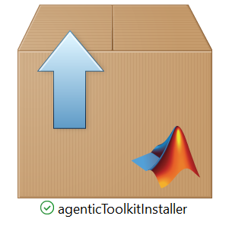
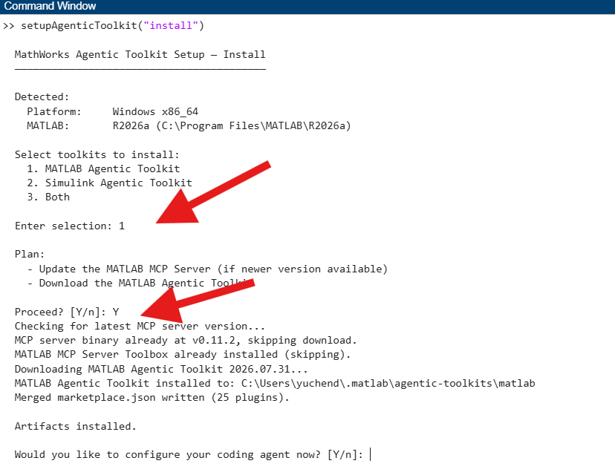
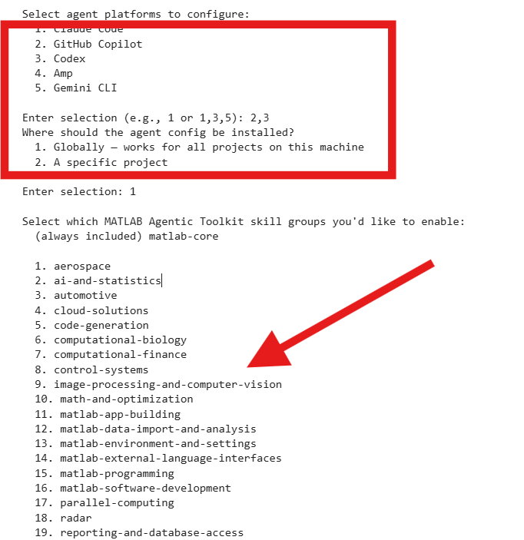
Quick Start with MATLAB Agentic AI Toolkit
5 steps to set up:
  Download the installer, click agenticToolkitInstaller.mltbx.

Slide 9

How to get started (today)?
MATLAB Online URL:
https://www.mathworks.com/licensecenter/classroom/5595200/

Slide 10
What is Context?
Context is the information available at model inference
The size of context window denotes how much information the model can process at once, measured in tokens
  Typical Size: 200K - 400K
  Codex GPT-5.4: 1M
“You are Codex, a coding agent …”
“Instructions to Tools, Skills, MCP…”
“Permissions…”
“Global AGENTS.md”
“Project AGENTS.md”
“Create a plot ….”
“Tool call ….”
“Response ….”
“Add a legend ….”
LLM Inference
“Skill call ….”
“MCP call ….”
“Response ….”
…
“Generate a report ….”

Slide 11
Context Hierarchy
A lot happened before the conversation start
“You are Codex, a coding agent …”
System
Instructions
“Instructions to Tools, Skills, MCP…”
“Permissions…”
“Global AGENTS.md”
Auto-Loaded
Context
“Project AGENTS.md”
Your first prompt
“Create a plot ….”

Slide 12
Context Hierarchy
First Prompt
Second Prompt
Nth Prompt
“You are Codex, a coding agent …”
“You are Codex, a coding agent …”
“You are Codex, a coding agent …”
“Instructions to Tools, Skills, MCP…”
“Instructions to Tools, Skills, MCP…”
“Instructions to Tools, Skills, MCP…”
“Permissions…”
“Permissions…”
“Permissions…”
“Global AGENTS.md”
“Global AGENTS.md”
“Global AGENTS.md”
“Project AGENTS.md”
“Project AGENTS.md”
“Project AGENTS.md”
“Create a plot ….”
“Create a plot ….”
“Create a plot ….”
“Tool call ….”
“Tool call ….”
“Response ….”
“Response ….”
“Add a legend ….”
“Add a legend ….”
“Skill call ….”
Conversation history are accumulated
“MCP call ….”
“Response ….”
…
“Generate a report ….”
Context Window Limit

Slide 13
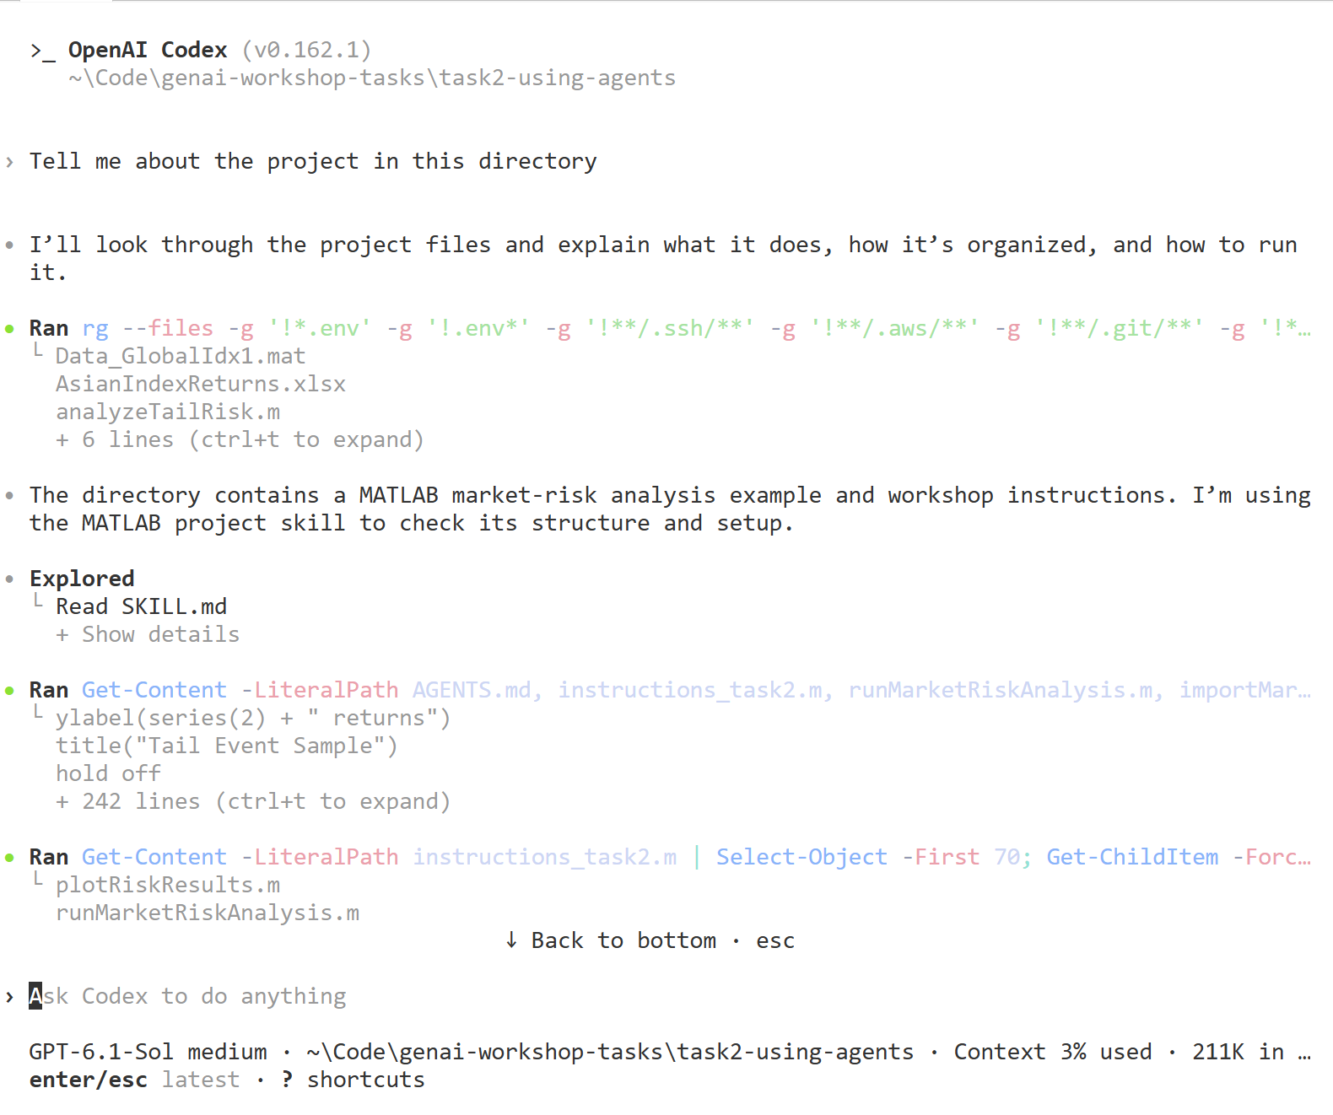
Task 2
Notes:
Using tools – rg
Reading skills

Slide 14
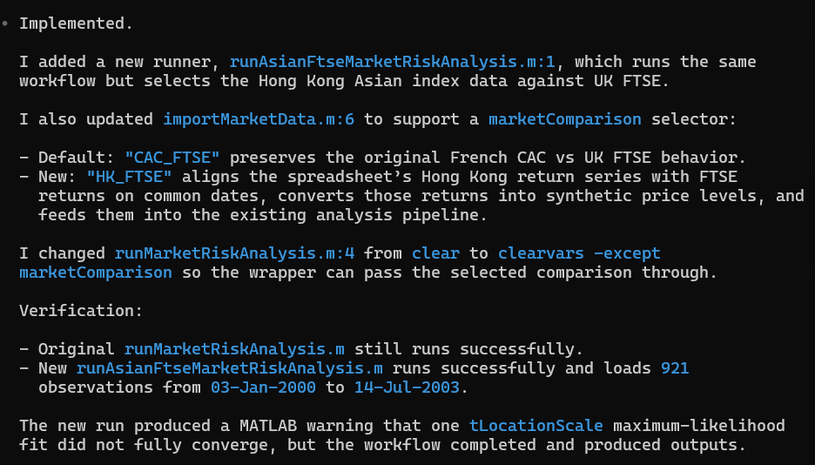
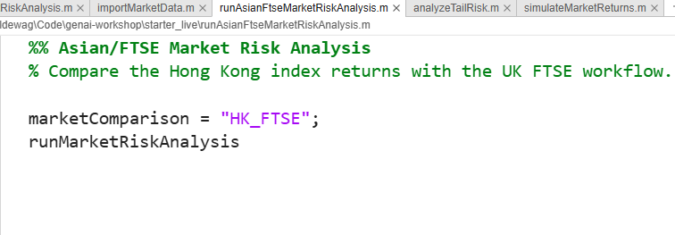
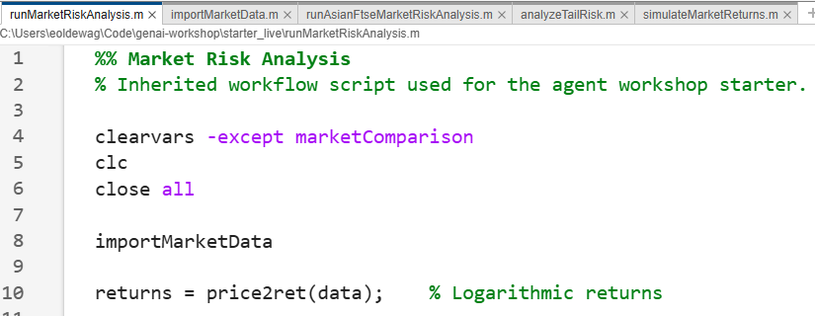
Task 2
Notes:
It’s very optimistic about it’s implementation.
<CLICK>
But sometimes the implementation is not particularly good. For example, here it just adds a new marketComparison variable before calling the script and then edits the original script to not clear that variable. This is (a) unintuitive (why would you want to clear all variables except this particular one?) and (b) can lead to some unexpected side effects

Slide 15
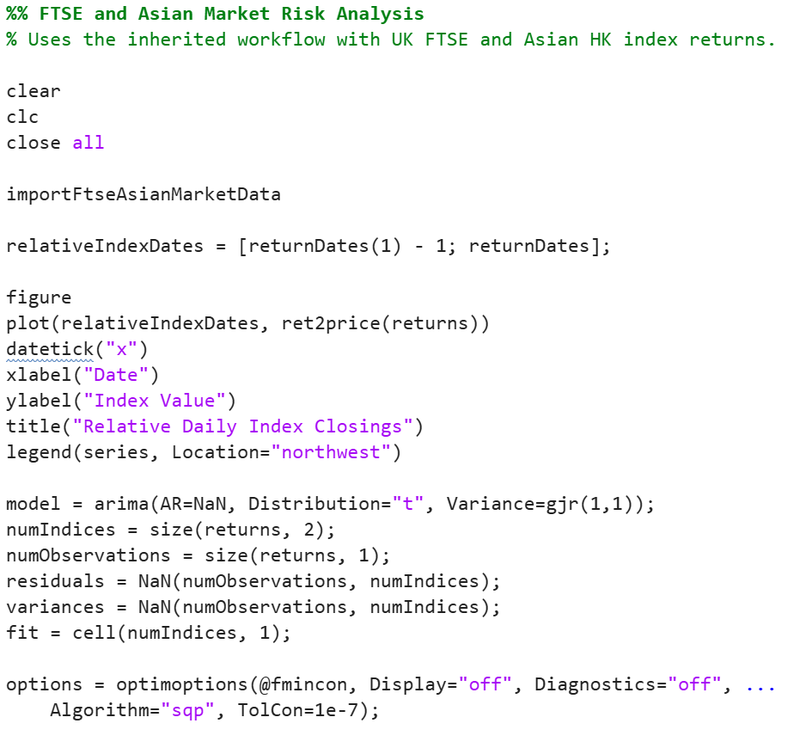
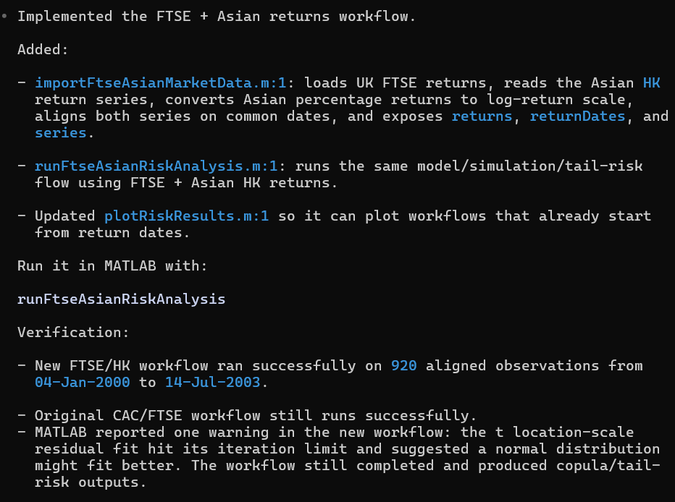
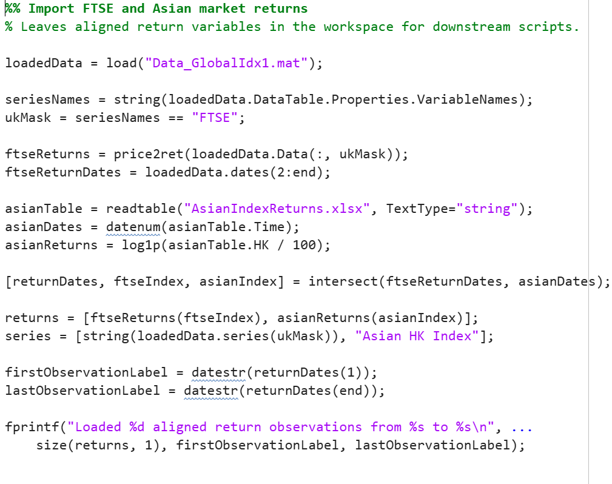
Task 2
Notes:
Here’s another example. In this case, it created a whole new importer script just for the Ftse and Asian market data.
<CLICK>
So far so good, at least the runner script stays clean looking
<CLICK>
But if you look at the new script, there’s significant duplication – it’s doing basically the same thing as the original script, except the French data isn’t loaded too. That’s a lot of code duplication.

Slide 16
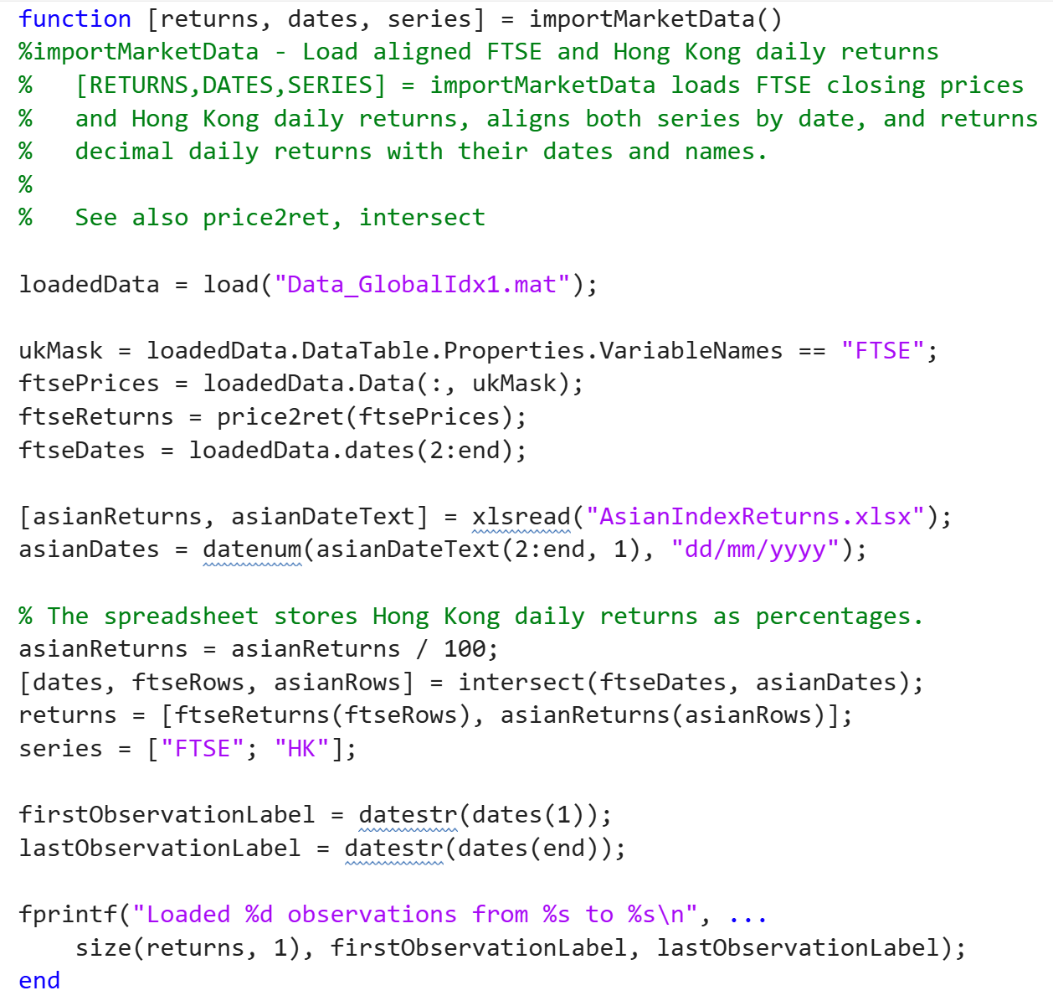
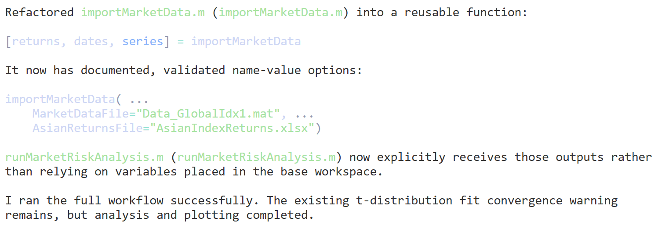
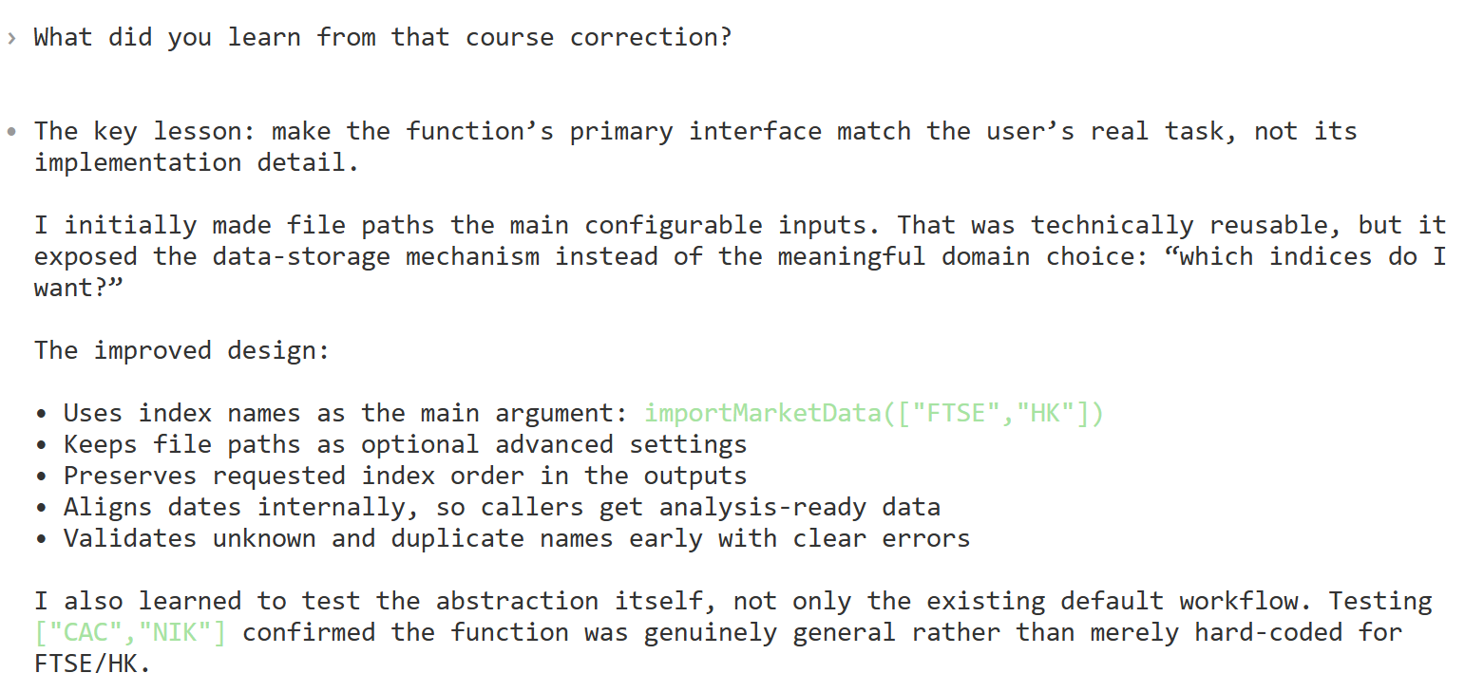
Task 2

Slide 17
Working with Agents Efficiently
Don’t repeat yourself
Think first
Use deterministic tools and correctness checks
Not all tasks are the same.
Some just need to happen quickly, but for others correctness, verifiability and maintainability matter.

Slide 18
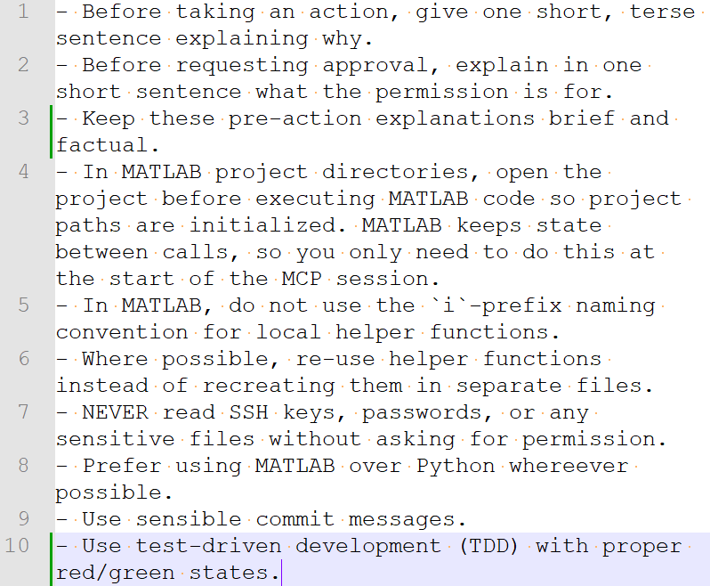
Working with Agents Efficiently
Don’t repeat yourself
Use AGENTS.md to give standing instructions
AGENTS.md is loaded by default when you start the agent in a project directory
  Early in the mode’s context window
AGENTS.md should be short
  Ideally 30 – 50 lines
  No longer than 150 lines
AGENTS.md nest, so you can give general
instructions at user-level and more specific
project instructions
These instructions are strong suggestions
– the model may forget them in long sessions

Slide 19
Attention Mechanism
LLMs use an attention mechanism that assigns different importance weights to tokens. Tokens at the beginning or the end tend to receive more attention than those in the middle of long contexts.
Attention Mechanism
Place key instructions at the beginning / end
Surface key information explicitly
Keep context focused, not maximal
“System Instructions”
“Global AGENTS.md”
“Project AGENTS.md”
“Review the code ….”
“Tool call ….”
“Response ….”
“Fix the syntax ….”
“Skill call ….”
“MCP call ….”
“Response ….”
“Implement the new ….”

Slide 20
Writing Effective AGENTS/CLAUDE.md File
Don’t repeat yourself
AGENTS.md should provide the smallest set of high-signal information that guides the agent effectively
Do’s
Core project information only
Keep it short, ~ 200 lines
Refine only when failure occurred
Don’ts
Document everything
Write overly detailed instruction
Restate known knowledge

Slide 21
When things cannot fit
If your context can fit in ~200 lines:
Keep a single AGENTS.md file
If not:
Leverage sub-directory Agents.md
Use skills for workflows instructions
Provide reference
I need them all

Slide 22
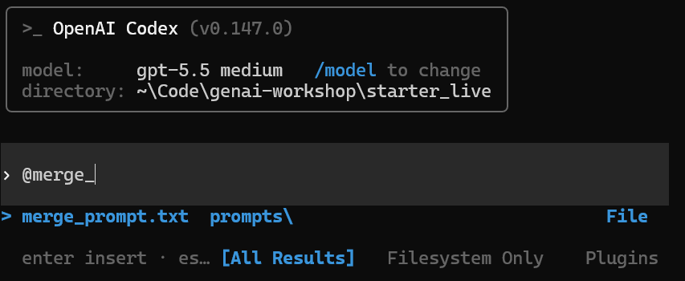
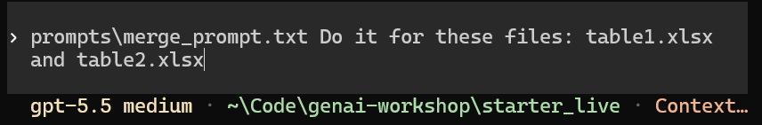
Working with Agents Efficiently
Don’t repeat yourself
Reuse prompts for tasks that you do frequently
Example: Merge these two files. Where column headings don’t match up, create new columns, keeping the original column name. Make sure to preserve all the data from the two files you are merging, don’t throw any data away. Treat missing data as NaN or empty strings, depending on the type.
Tip: Use @ to attach files to the message

Slide 23
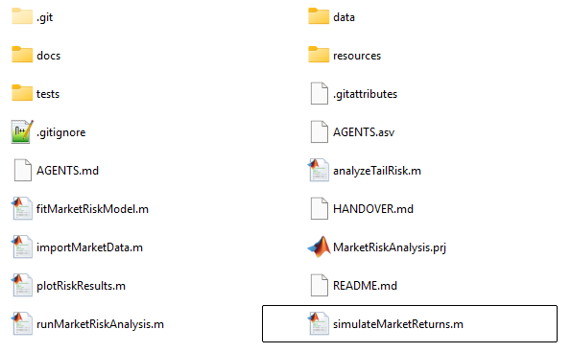
Working with Agents Efficiently
Don’t repeat yourself
Use reference projects/examples
Examples of existing conventions, architecture, etc.
Reduces how much additional context you need to provide manually
Even for new projects, starting with an
example of something similar can be
very helpful

Slide 24
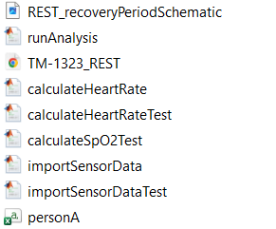
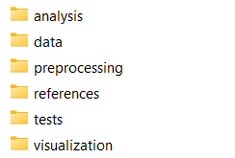
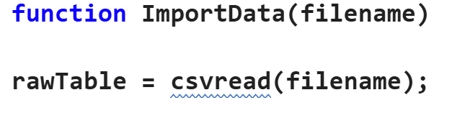
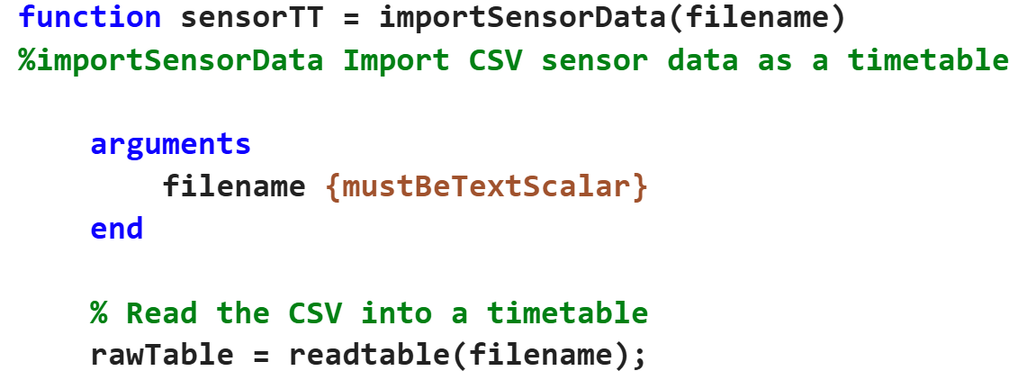
Project Structure Matters
The quality of the generated AGENTS.md depends heavily on your codebase
Your codes are critical examples for the agent
Don’t pollute your context with
  poor file organization
  inconsistent implementations

Slide 25
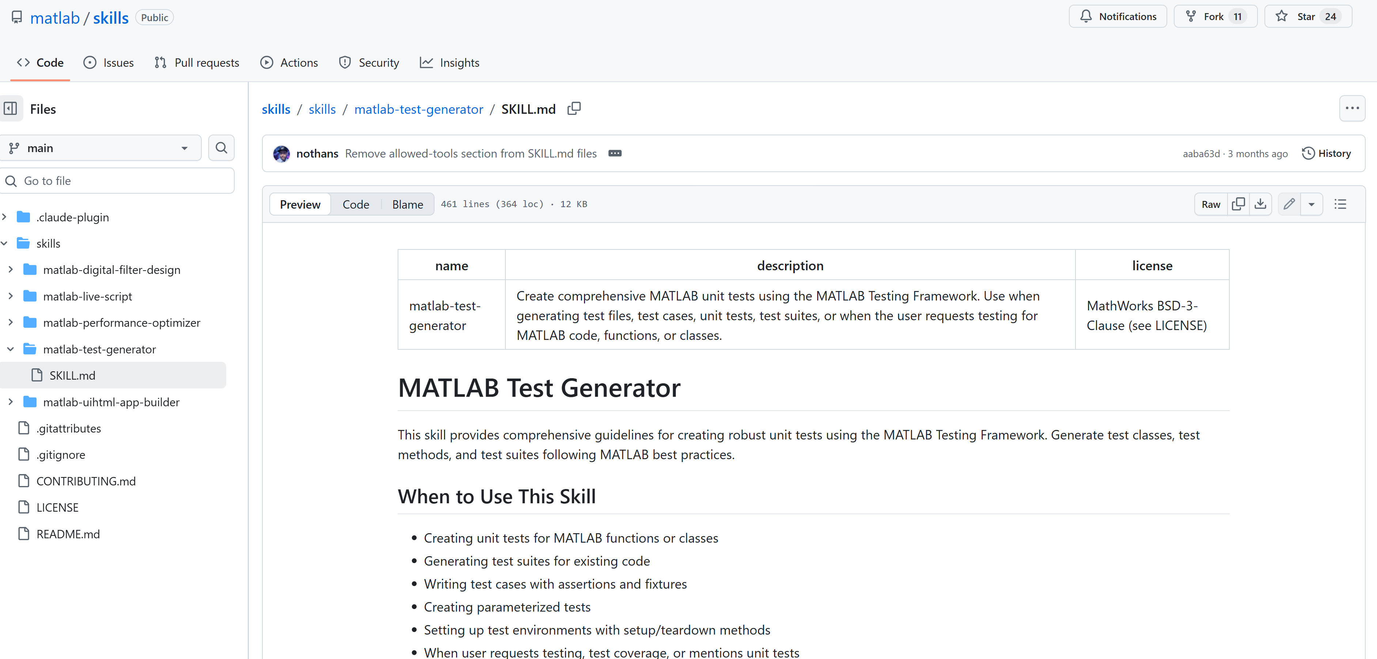
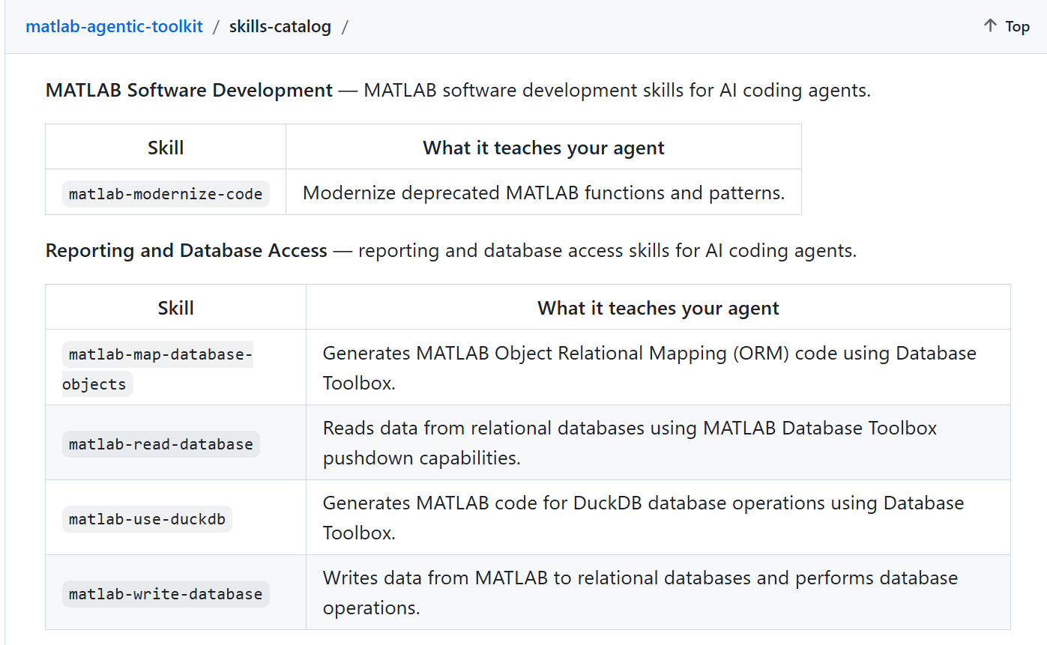
Working with Agents Efficiently
Use skills
Provide additional context for tasks using skills. Skills:
Are markdown files that contain additional information about how to do something
Can exist in folders that contain other information, e.g. example code
Follow a particular format to make them discoverable to agents
Are called automatically if they are relevant to the task
MATLAB skills catalogue is expanding rapidly

Slide 26
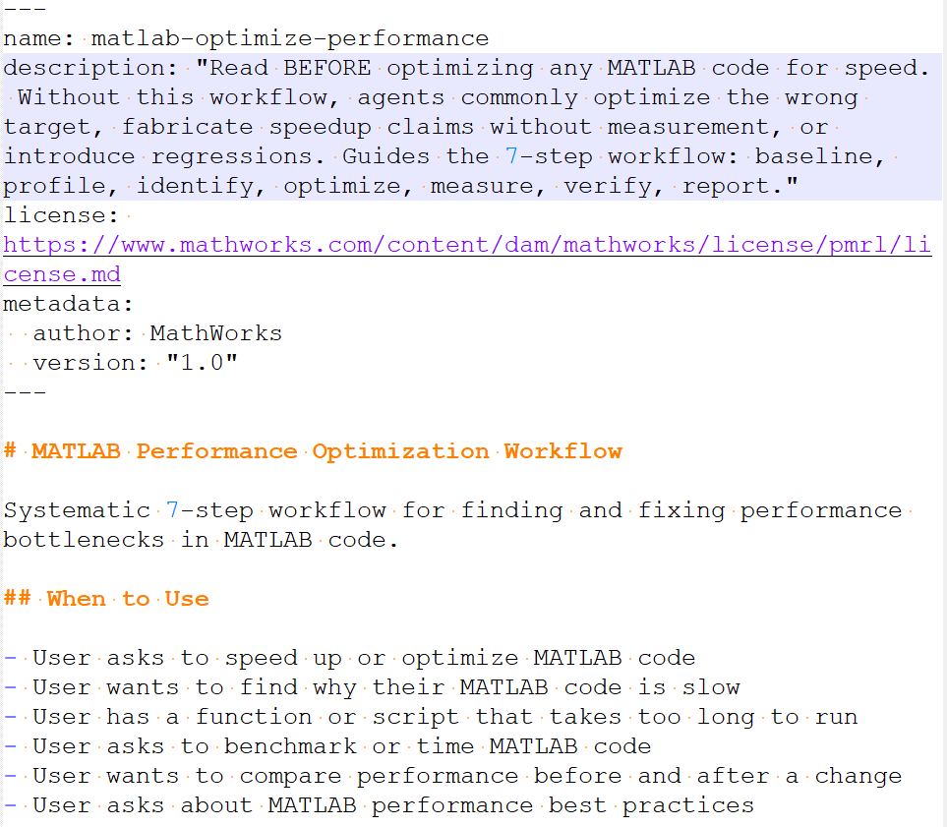
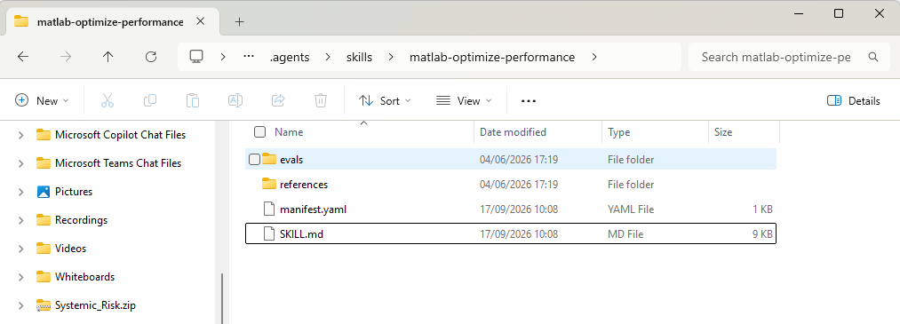
Working with Agents Efficiently
Use skills

Slide 27
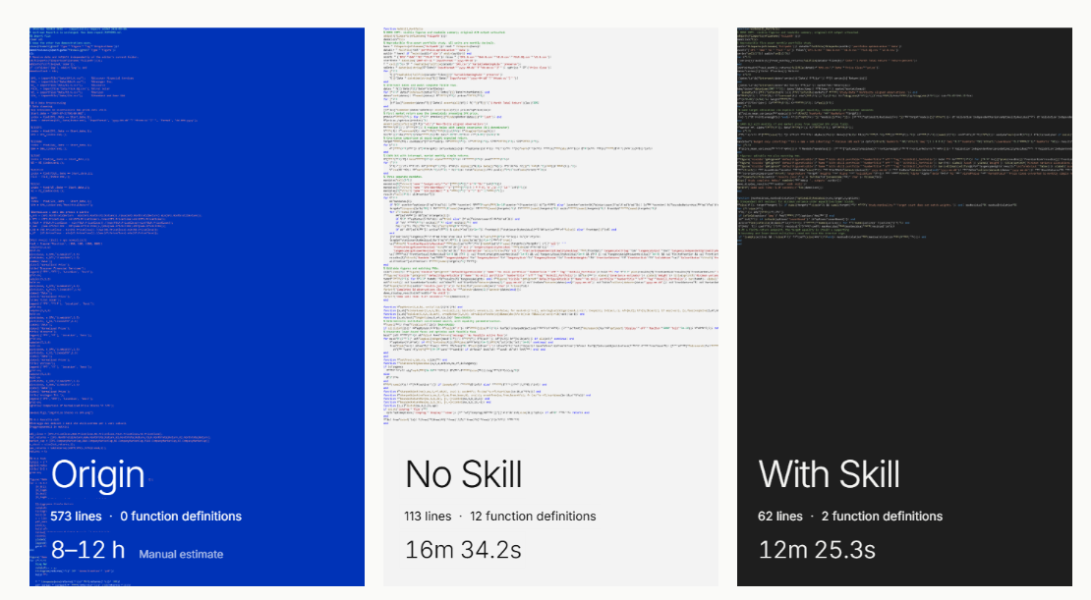
Coding Agent: With and Without Skills

Slide 28
Agent Skills
Skills use progressive disclosure to manage context efficiently.
.agents/skills/skill-name/SKILL.md
---
name: skill-name
description: Defines the conditions under which the skill should or should not be triggered
---
# Instructions
This section is loaded by the agent only if it determines, based on the skill description, that the content may be relevant to the current task.
skill-name/
├── SKILL.md # Required: metadata + instructions
├── scripts/ # Optional: executable code
├── references/ # Optional: documentation
├── assets/ # Optional: templates, resources
└── ... # Any additional files or directories
Notes:
https://agentskills.io/what-are-skills
Skills use progressive disclosure to manage context efficiently:
Discovery: At startup, agents load only the name and description of each available skill, just enough to know when it might be relevant.
Activation: When a task matches a skill’s description, the agent reads the full SKILL.md instructions into context.
Execution: The agent follows the instructions, optionally loading referenced files or executing bundled code as needed.
This approach keeps agents fast while giving them access to more context on demand.

Slide 29
Progressive Disclosure
In agentic workflows, instructions, tools, and procedures often apply only at specific stages. Disclose information only when needed.
Skills, MCP, Rules …
YAML frontmatter + instruction body
“You are Codex …”
---
name: App Creation
description: Create MATLAB App
---
“YAML Frontmatter Skills, MCP…”
“Global AGENTS.md”
“Project AGENTS.md”
## Step 1
xxxxxxxxxxxxxx
## Step 2
xxxxxxxxxxxxxxx
“Create an App ….”
“Skill call ….”
“Response ….”

Slide 30
How to use a skill?
Load
Invoke
Invoke
$command
Action
Prompt
Action
Prompt

Slide 31
MATLAB Skills for your agents
Upskill your agent for your specific purpose:
Skills are a simple, open format for giving agents new capabilities and expertise
MATLAB skills catalogue is expanding rapidly
Notes:
Some example skills for Claude
An example skill from our repo for generating tests
These are literally just markdown files with a particular format, containing relevant info about the skillset you want the agent to have

Slide 32
How can we improve agent behavior?
Skills transform prompts into reliable, domain-aware, reusable workflows
Right knowledge at the right time
Reliability and output quality
  Encoding proven procedures
  Grounding against hallucination
Knowledge the model may not have
  Domain and proprietary expertise
  Institutional memory
/skills/skill-name/SKILL.md
---
name: skill-name
description: Defines the conditions under which the skill should or should not be triggered
---
# Instructions
This section is loaded by the agent only if it determines, based on the skill description, that the content may be relevant to the current task.
Skills tells your agent how to do things correctly the first time around

Slide 33
Working with Agents Efficiently
Write your own skills for recurring tasks
Write your own skills
Create SKILL.md
Include a name, description and a body
  Make the name of the skill descriptive so it
  triggers correctly
  The description is the “advert” for the skills.
  Also important for correct triggering
  The body tells the agent how to do the task
See the spec here
You can manually trigger a skill with @
or my finding it with the /skills command

Slide 34
How to create a skill?
Assets:
Domain-Knowledge
Code files
Standards
Templates
References
…
Generate
Write/Edit
Prompt

Slide 35
Working with Agents Efficiently
Don’t repeat yourself
  Use AGENTS.md
  Reuse prompts
  Use reference projects
  Use skills – and write your own
Think first
Use deterministic tools and correctness checks

Slide 36
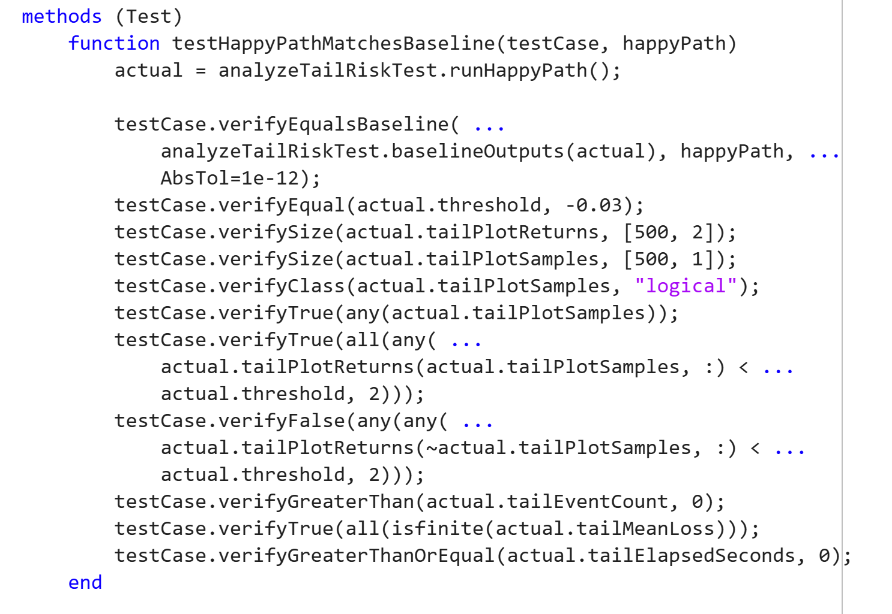
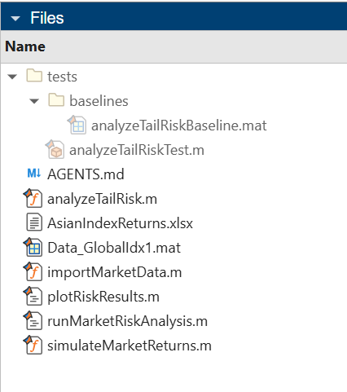
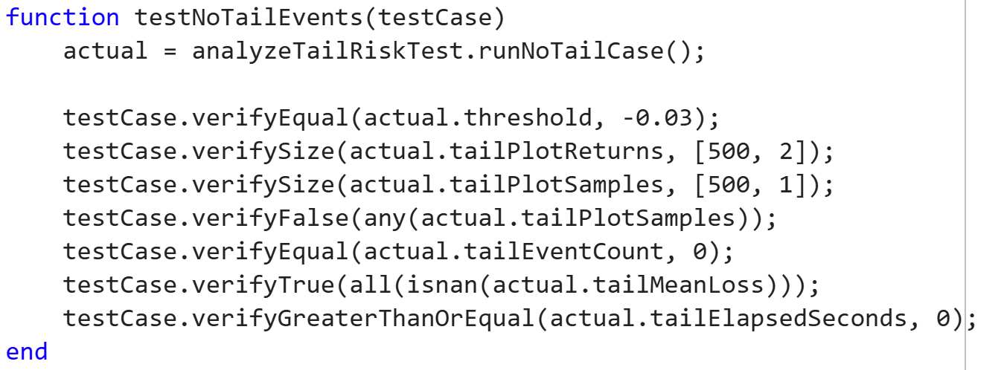
Task 3
Notes:
We’ve got a nice class-based test and a .mat file of baseline outputs.
Are these good tests? I think they’re fine.
Are they extensive? Certainly not.

Slide 37
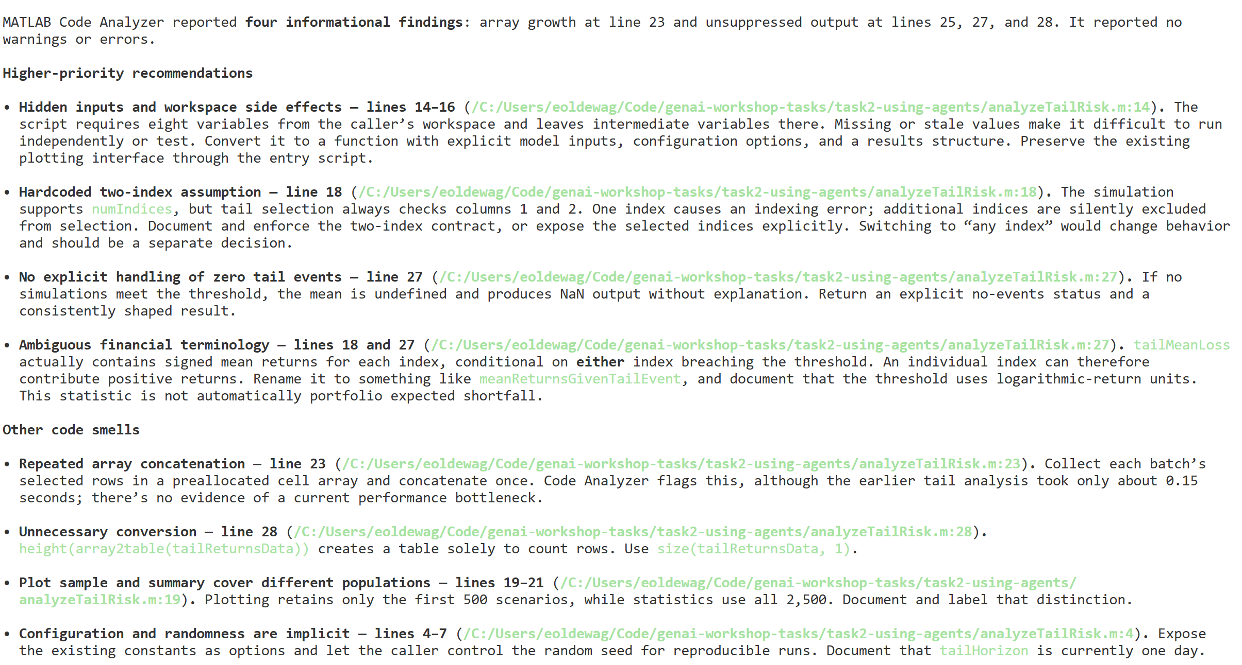
Task 3

Slide 38
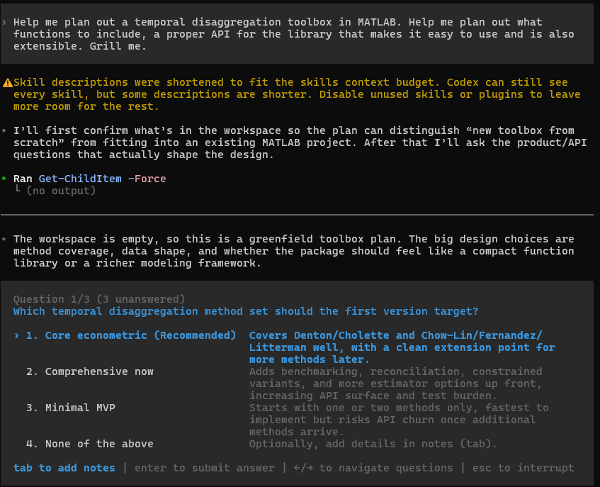
Working with Agents Efficiently
Think First
Use plans to make sure you are building the right thing
Useful to think through the approach
Prompt ideas:
  Consider potential knock-on implications
  Grill me
  Ask me anything I haven’t thought about
  Don’t make assumptions*
  *Usefulness depends on model capability

Slide 39
Plan Mode
Normal Mode
Plan Mode
Iterate
Action
Prompt
✓
Plan
Proceed?
Action
Prompt
Action
✗
✓
✓
✓
✓
✓

Slide 40
Feature Design
Plan first
  Plan mode is read-only to prevent unintended changes
  Plan mode leverages subagents to keep context clean
Leverage domain-specific skills
  Use appropriate functions instead reinvent from scratch
  Skills are on-demand context
Implementation
  Structure your validation process
  Inspect the result yourself

Slide 41
Working with Agents Efficiently
Think first
Don’t repeat yourself

Slide 42
Working with Agents Efficiently
Don’t repeat yourself
  Use AGENTS.md
  Reuse prompts
  Use reference projects
  Use skills – and write your own
Think first
Use deterministic tools and correctness checks
  Use test and test-driven development
  Use version control

Slide 43
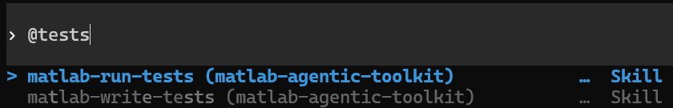
Working with Agents Efficiently
Use deterministic checks
Reduces the burden on you to review the agent’s outputs
Use tests to your advantage
Your agent can write baseline tests
  Establish what the code “currently does” and assumes that is correct
Give reassurance that the behaviour of the code hasn’t changed silently
Use test-driven development
All tests pass
Write test for new feature/bug
(which fails)
Work on new feature/bug
All tests pass

Slide 44
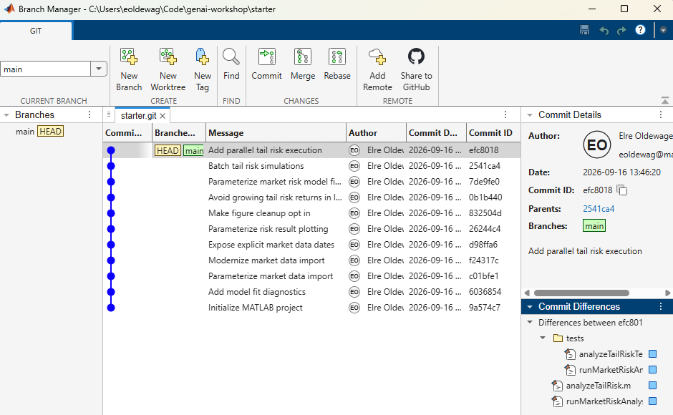
Working with Agents Efficiently
Use deterministic tools
Use version control to track state safely
Depending on your security
requirements, your agents can
handle version control for you
Allows you to undo changes to
the repo
Use continuous integration to
ensure tests run.
Or more simply, pre-push hooks

Slide 45
Accelerate your MATLAB productivity with GenAI
Agentic Workflows
External GenAI Agents
use MATLAB with external Agents
via MCP or VS Code
Build Agents in MATLAB
call LLMs from MATLAB code
AI Assistants
MATLAB Copilot
optimized for MATLAB
Notes:
Let’s see how we’re accelerating productivity with Generative AI.
[click]
First, we’ll talk about copilots for MATLAB and Simulink. These are integrated directly into the MATLAB and Simulink environments.
[click]
Second, we’ll look at how you can use MathWorks tools with AI agents – enabling agents to interact with MATLAB and Simulink.
[click]
Third, we’ll see how you can develop GenAI-powered applications in MATLAB by writing MATLAB code that calls LLMs
[click]
And fourth, we’ll look at all the other ways you can use MATLAB with other Generative AI tools. No matter where you’re accessing Generative AI tools – there’s probably a way to use them with MATLAB.

Slide 46
Questions?

Slide 47
Isolate Context using Subagents
Main Agent
“You are Codex …”
Subagent
“YAML Frontmatter Skills, MCP…”
“You are Codex …”
“Global AGENTS.md”
“AGENTS.md …”
“Project AGENTS.md”
“Subagent instructions …”
Delegate
“Create an App ….”
“Search …”
“Skill call …”
“Read …”
“Response …”
Return
“Summarize …”
“/agents research …”

Slide 48
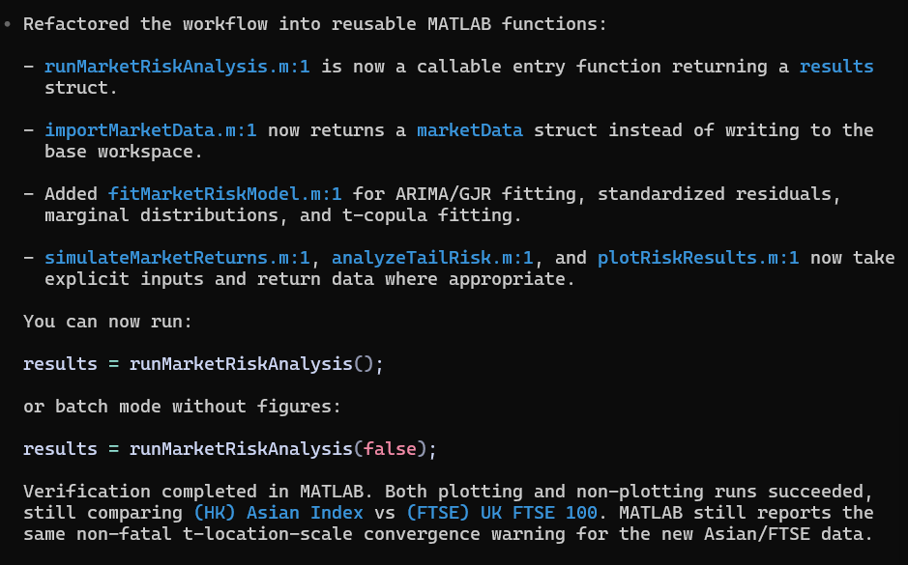
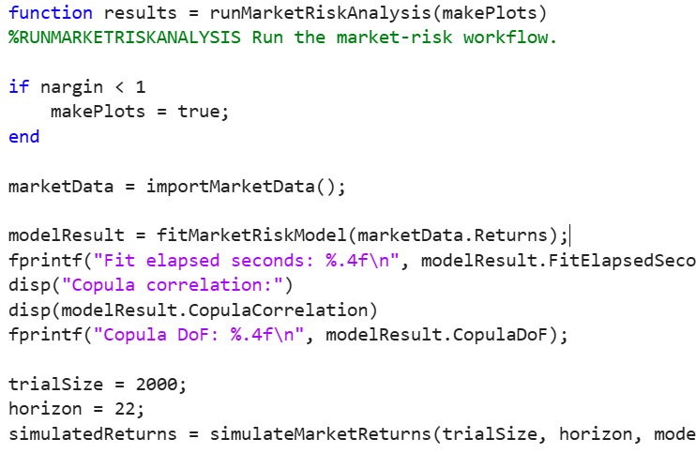
Notes:
Here the runner script has been refactored into a callable function.
<CLICK>
But the only arguments it takes as input is whether or not to make plots. All the other parameters are hardcoded and can’t be changed

Slide 49
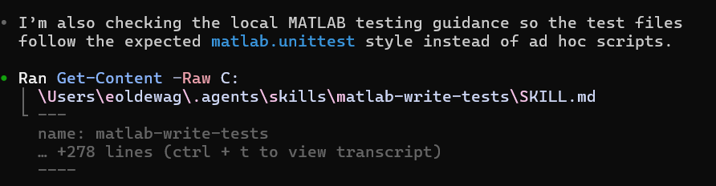
Notes:
Here the agent calls the unit test skill

